Slide 1
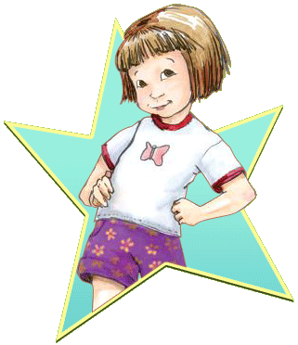
Ramona’s World
By Beverly Cleary
Presentation by Lacey Tew

Slide 2
Ramona Spreads the News
Ramona has a new sister.She meets Yard Ape on the bus. Writes a paragraph herself.

Slide 3
The role Moldel
Ramona has just found out her sister Beezus is responsible.She talked to her mom about what she’s mad about.She tought her sister to stick her tongue out.

Slide 4
At Daisy’s House
Ramona just got invited to Daisy’s house. Daisy’s cat loves to be vacuumed. Daisy’s brother calls her fence face.

Slide 5
The Invitation
Beezus just got a invitation to a party. Beezus also got earings and such. Ramona had never seen such nice earings.

Slide 6
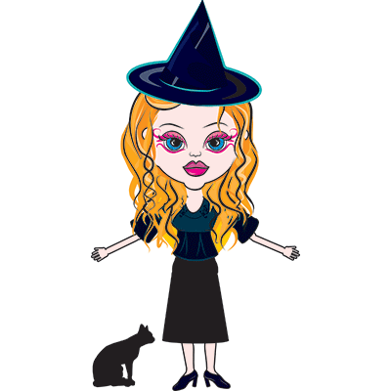
The Princess and the Witch
Ramona just fell though a ceiling . Ramona did not have pants on. A boy saw her bare leggs.

Slide 7
The Party
Beezus went to her friend’s party. Ramona had to go to bed but she stayed up. Beezus came home happy.

Slide 8
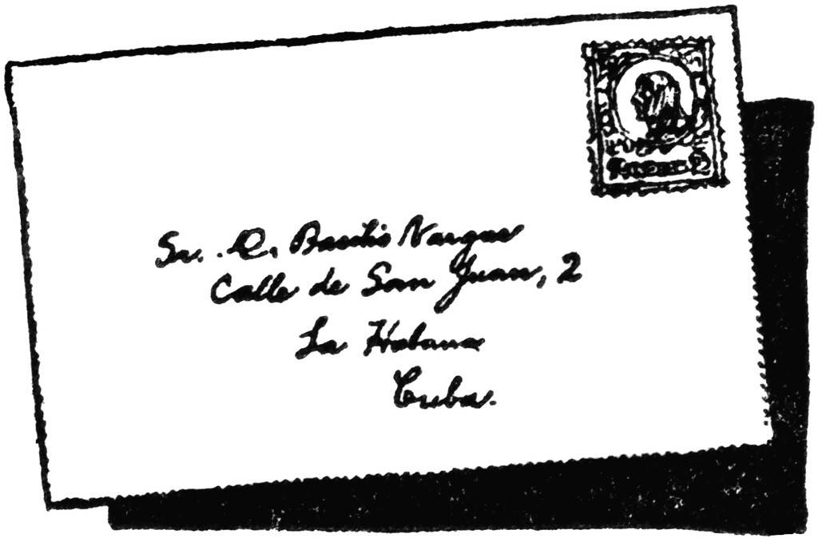
The grown up Letter
Ramona and Daisy just wrote a letter. Romona and Daisy wort it to a tax place. They worte it because they spelled something worng.

Slide 9
Peas
Ramona had to feed her baby sister. Roberta made a big mess. Ramona got all dressed up for a picture. She made a bad face.

Slide 10
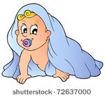
Ramona sits
Ramona has just been asked to baby-sit. The baby was her sister. Her sister got stuck where the cat naps.

Slide 11
The Valentine box
Ramona has just made a card for Yard Ape. It was a bad picture of Ramona. Yard Ape gave her a nice poem.

Slide 12
Birthday Girl
Ramona has just had a birthday. Instead of iceing they had wipped cearm on her cake. Sadly Susan cried.

