Slide 1




BACK TO SCHOOL
Meet The Social Worker

Slide 2



School Social Worker
Nice
to meet you!
I am thrilled to be the School Social Worker at Center Street School. I have been the school social worker here for the last 13 years 1and have a passion for helping students.

Slide 3
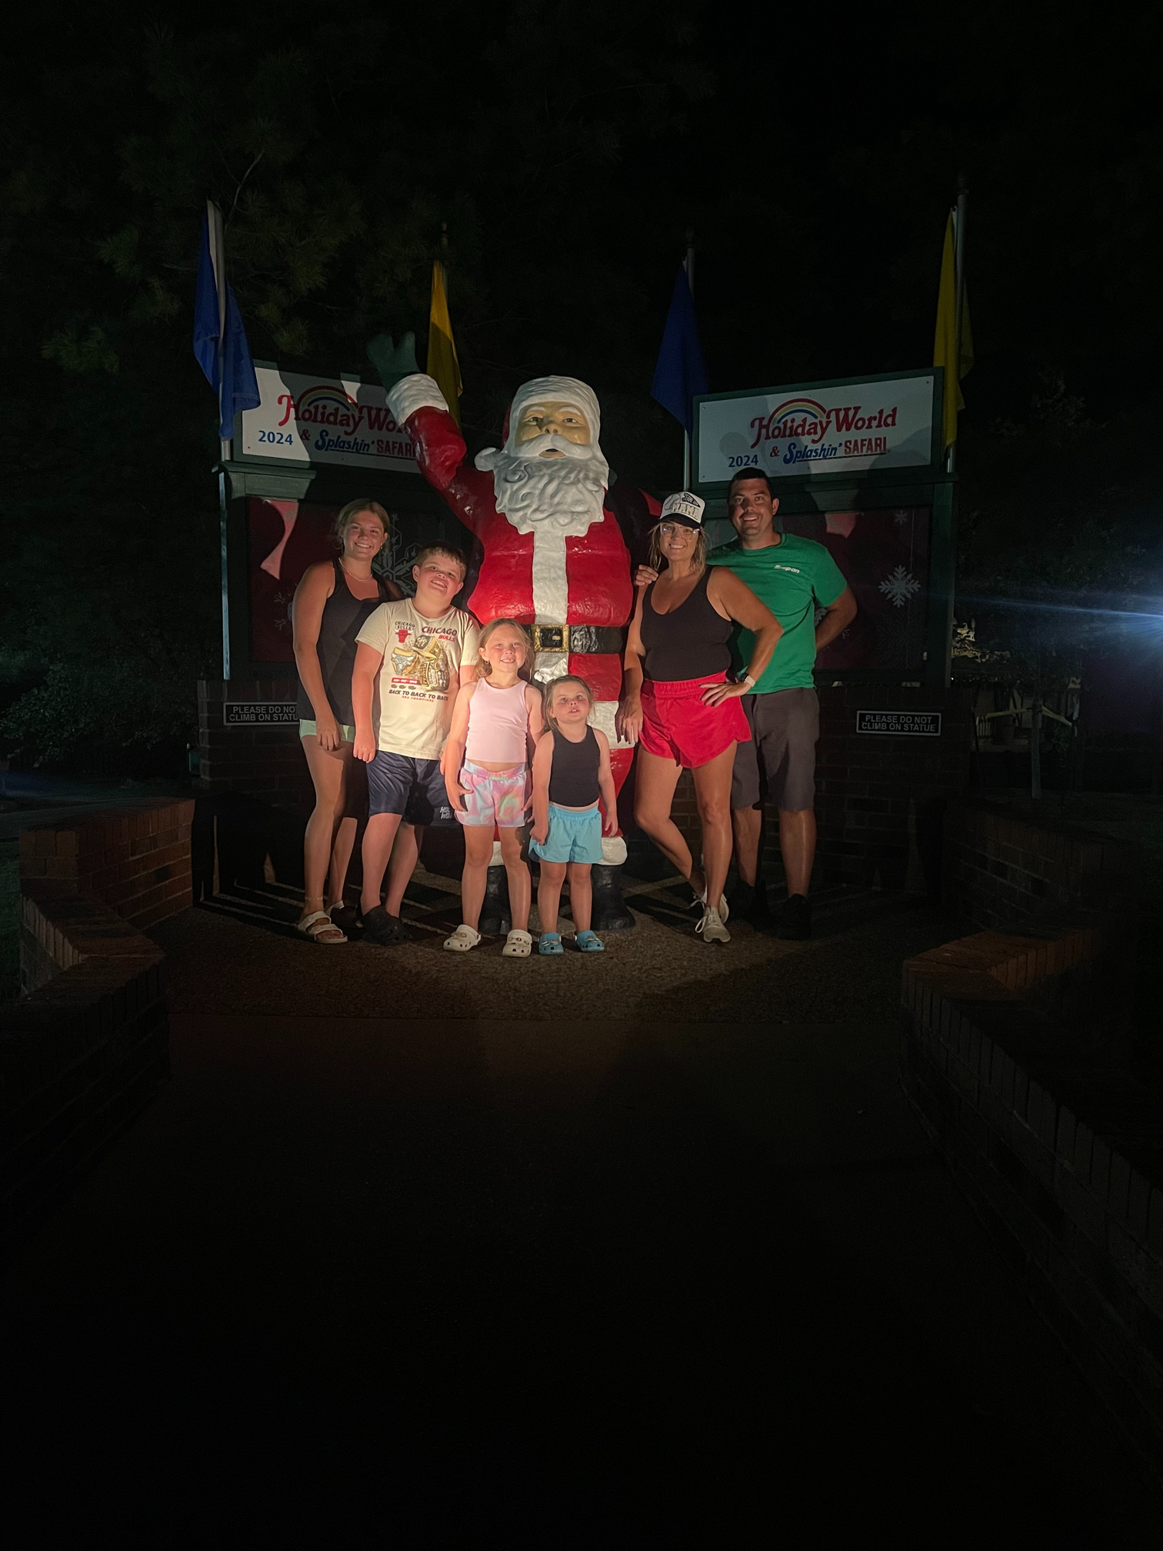
Meet my Family
I am excited to introduce you to the most important people in my life.
My family is my support system and they inspire me to be the best
version of myself.

Slide 4
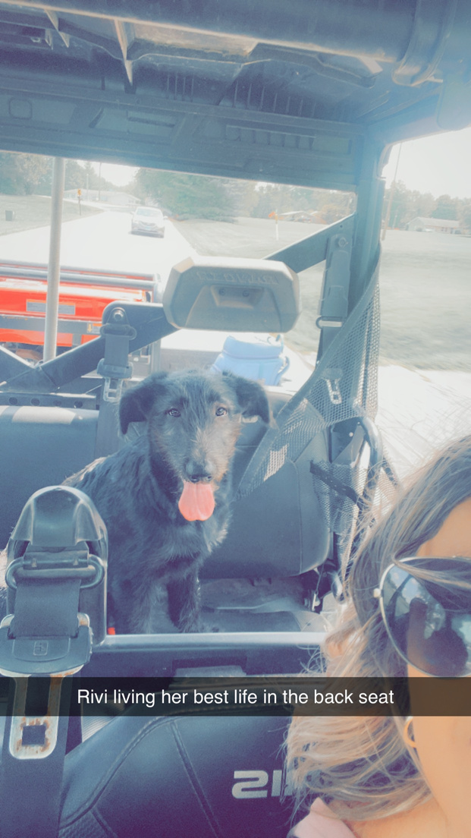
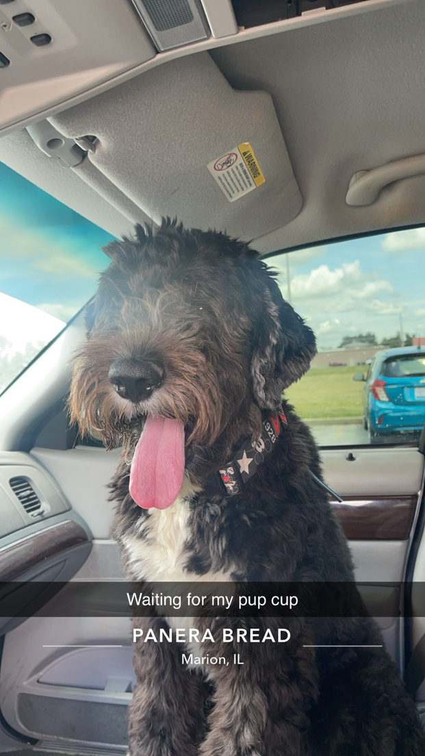

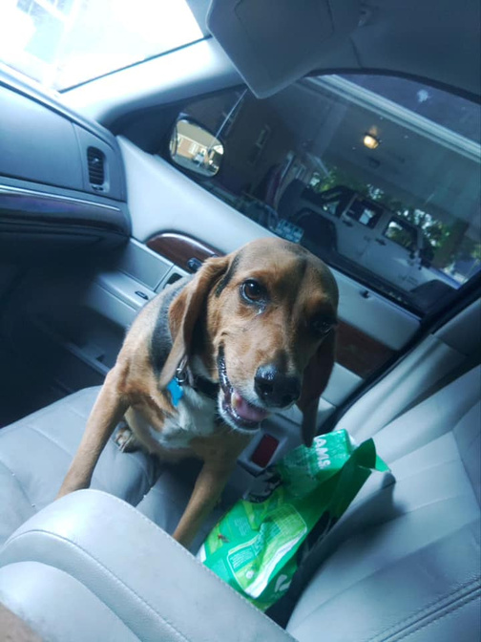

Meet my Pets!

Slide 5



Meet Favorite Things
I love Lemonade with Sugar Free Peach from Gingerale’s
I love chips and salsa
I love going shopping

Slide 6



Teaching Experience
I have had the privilege of helping students and families address issues that may impact learning and competence, and improve students' emotional well-being and academic performance

Slide 7


In My Office
I strive to create a welcoming and supportive environment where students feel comfortable taking risks and learning from
their mistakes.

Slide 8



In My Free Time
SPEND TIME WITH MY FAMILY
WATCH MY KIDS PLAY SPORTS
GOING ON RANGER RIDES

Slide 9



Get in touch!
Phone: 618-842-2679
Email: bethrichards@fairfieldcolts.com
Website: www.fairfieldcolts.com

Slide 10


It's Going to be a Great Year!
See
you soon!

